Slide 1
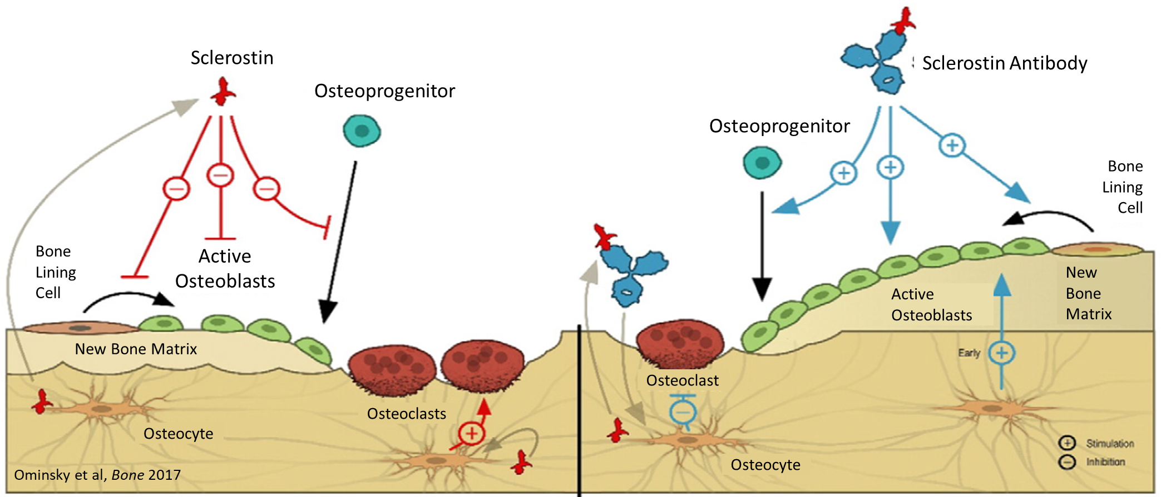
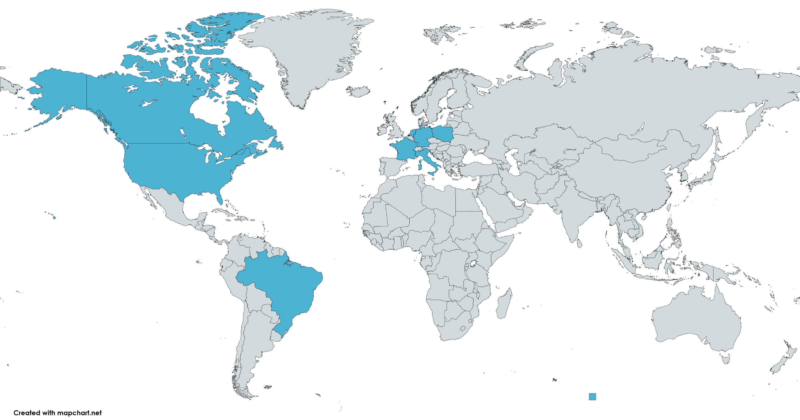
Cosmic: An Open-Label, Randomized, Active-Controlled, Phase 3 Study of Setrusumab Compared With Bisphosphonates in Pediatric Subjects With Osteogenesis Imperfecta
R. Barbarash¹, T. Carpenter², M. Bober³, G. Gottesman⁴, O. Semler⁵, T. Félix⁶, L. Ward⁷, H. Wang¹, H. M. Byers¹, S. Krolczyk¹
¹ Ultragenyx Pharmaceutical Inc.; ² Yale University School of Medicine, New Haven, CT, USA; ³ Nemours Children’s Hospital, DE Wilmington, Delaware, USA; ⁴ Washington University School of Medicine, St Louis, MO, USA; ⁵ University Hospital, University of Cologne, Cologne, Germany; ⁶ Medical Genetics Service of Hospital de Clínicas de Porto Alegre, Porto Alegre, Brazil; ⁷ Children's Hospital of Eastern Ontario, Ottawa, Ontario, Canada
Authors declare the following potential COIs: R. Barbarash, H. Wang, H. Byers, and S. Krolczyk: Employee and stock owner: Ultragenyx; T. Carpenter: Research Investigator (funds to institution): Ultragenyx; Advisory Board and consultant: Ultragenyx, consultant: Inozyme, Kyowa Kirin. M. Bober: Research investigator (funds to former institution): Ultragenyx; Consultant: Ultragenyx and Mereo. G.S. Gottesman: Research Investigator (funds to institution): Ultragenyx; Advisory Board and consultant: Ultragenyx; Advisory Board and consultant; Kyowa Kirin. T. Félix: Research investigator (funds to institution): Ultragenyx. L. Ward: Research investigator (funds to institutuion) and consultant: Ultragenyx
BACKGROUND
COSMIC STUDY DESIGN
Osteogenesis imperfecta (OI) is a rare genetic disorder, characterized by reduced bone mass and increased bone fragility¹
The majority (85%–90%) are caused by mutations in COL1A1 or COL1A2, which encode type I collagen^{2,3} (OI Types I, III, and IV)
There are no globally-approved therapies for OI; pharmacologic management relies on bisphosphonates and calcium/vitamin D supplementation
Fractures and complications continue to be reported in treated patients
Setrusumab is a fully human monoclonal antibody that inhibits sclerostin, thereby increasing wnt signaling related bone formation while reducing bone resorption⁴ (Figure 1)
Addition of new lamellar bone at trabecular, periosteal, and endocortical surfaces may uniquely increase bone mass and strengthen the skeleton
A Phase 2b study in adults with OI showed increases in bone remodeling with setrusumab across OI Types I, III, and IV (Asteroid; NCT03118570)
A pivotal Phase 2/3 study is ongoing to determine dose of setrusumab and its efficacy and safety in pediatric and young adults with OI​ (Orbit; NCT05125809)
Study Schema
Active-controlled period
Extension period
Bisphosphonate (n= ~25-33)
Screening
Setrusumab
Randomization 1:1
Setrusumab (n= ~25-33)
Baseline
Month 24
Treatment extension until commercial availability
End of Trial
Key Inclusion criteria:
Male or Female aged 2 to < 7 yrs.
OI Type I/III/IV (COL1A1/ COL1A2 mutation)
≥1 fracture in the past 12 months, ≥2 fractures in the past 24 months, or ≥1 femur, tibia, or humerus fracture in the past 24 months
Prior or current IV-BP
Serum 25-hydroxyvitamin D level ≥ 20 ng/mL at screening
Key Exclusion criteria:
History of skeletal malignancies, bone metastases or neural foraminal stenosis
Clinical manifestations of Chiari malformation or basilar invagination
Current uncontrolled concomitant diseases that may impact bone metabolism
Any skeletal condition (other than OI) leading to bone deformity and/or increased risk of fractures
Estimated glomerular filtration rate ≤ 35 mL/min/1.73 m² at screening
Cardiovascular disease
Primary Analysis
Final Analysis
Figure 1. Setrusumab Increases Bone Formation, Reduces Bone Resorption
Intravenous bisphosphonates will be administered based on each subjects’ current bisphosphonates dosing regimen, or investigator discretion
Intravenous setrusumab will be dosed at 20 mg/kg once a month (QM)
All subjects may receive calcium and vitamin D supplements, if needed, as directed by the investigator
*Randomization stratified by number and severity of fractures in the previous 2 years:
≤4 fractures and no femur, tibia, or humerus fracture vs > 4 fractures or ≥1 femur, tibia, or humerus fracture
Participating clinical sites (as of October 2023)
Primary and Secondary Objectives and Endpoints
Key Elements of Study Design
This study is taking place at 23 clinical sites across the United States, Canada, Brazil, France, Germany, Italy, the Netherlands, and Poland
Objectives | Endpoints
Primary
Evaluate setrusumab vs intravenous bisphosphonates (IV-BP) on reduction in fracture rate, including morphometric vertebral fractures | Annualized rate of all radiographically-confirmed fracturesª, including morphometric vertebral fractures^{b} during the Active-controlled Period
Secondary
Evaluate setrusumab vs IV-BP on reduction in fracture rate, excluding morphometric vertebral fractures | Annualized rate of radiographically-confirmed fractures excluding morphometric vertebral fractures^{b} during the Active-controlled Period
Evaluate setrusumab vs IV-BP on health-related quality of life by caregiver report | Change from baseline in Pediatric Orthopedic Society of North America Pediatric Outcomes Data Collection Instrument (POSNA-PODCI) Sports/Physical Functioning and Pain/Comfort subscale scores at Month 12 of the Active-controlled Period
Evaluate the systemic exposure of setrusumab | Serum setrusumab concentration at scheduled time points
Assess the safety profile of setrusumab | Frequency, severity, and relationship to treatment of treatment-emergent adverse events, serious adverse events, and adverse events of special Interest
Evaluate the immunogenicity of setrusumab | Incidence of binding and neutralizing anti-setrusumab antibodies at scheduled time points
Active Control Arm: standard of care intravenous bisphosphonates
IV-BPs typically used in patients 2 to <7years with OI and history of significant fractures
Allows for setrusumab vs BP comparison
Subjects previously on BPs will continue their current (or PI-preferred) regimen
Determining Sample Size
Sample size calculation is based on the primary endpoint of annualized total fracture rate
~50 – 66 subjects will be randomized 1:1 to achieve ~77% - 87% power to evaluate the treatment difference between setrusumab and IV-BP at a one-sided significance level of 0.025
This assumes an annualized fracture rate of 2 for the IV-BP arm, a 60% fracture reduction with setrusumab, a negative binomial dispersion parameter of 1, and an equal follow-up of 2 years in the active-controlled period
Primary Endpoint
Fracture rate is the most relevant clinical endpoint for patients with OI
For more information, please visit www.ClinicalTrials.gov (NCT05768854).
ACKNOWLEDGEMENTS
We thank the participants and their families for participating in this study. The clinical development of setrusumab, including the Cosmic study, is sponsored by Ultragenyx Pharmaceutical Inc (Ultragenyx) and Mereo Biopharma (Mereo). Michael Bober was employed at Nemours Children’s Hospital at the time of this work and continues to volunteer at this institute; he is currently employed at Tyra Biosciences.
Third-party medical writing assistance was provided by Kariena Dill and paid for by Ultragenyx Pharmaceutical Inc.
ª All fractures are confirmed radiographically by central imaging ^{b} Morphometric vertebral fracture identified by change from baseline in Genant semi-quantitative scoring based on annual skeletal survey
SUMMARY
There is significant unmet need for medical therapy for children and adults with OI
Setrusumab has a unique mechanism of action: Bone formation and Bone resorption
Setrusumab has shown increases in BMD and bone strength in adults with OI
The observations in adults support a clinical study to investigate fracture rate reduction in children as is currently underway
Cosmic is a phase 3 study to compare the effect of setrusumab therapy vs IV-BP in children with OI aged 2 to < 7 years on fracture reduction
This pivotal study could potentially lead to regulatory approval for setrusumab as the first targeted therapy available for patients with OI types I, III, and IV
REFERENCES
Glorieux FH. Best Pract Res Clin Rheumatol. 2008; 22:85–100.
Bardai G, Moffatt P, Glorieux FH, Rauch F. Osteoporos Int. 2016; 27:3607–3613.
Basel D, Steiner RD. Genet Med. 2009; 11:375–85.
Ominsky M, Boyce RW, Li X, and Ke HZ. Bone, 2017; 96:63–75
Presented at the Pediatric Endocrine Society of Texas, Oklahoma, Louisiana, and Arkansas; April 5–7, 2024; San Antonio, Texas

