Slide 1
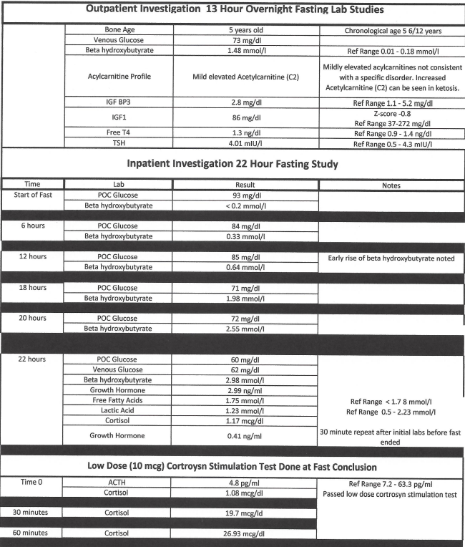
Empty Sella Syndrome Associated with FOXP1 Syndrome Joel Steelman MD, Ryan Lokkesmoe MD, Luke Hamilton MS
Background
FOXP1 syndrome is a rare autosomal dominant neurodevelopmental condition¹ caused by pathogenic variants in the forkhead box protein 1 (FOXP1) gene. Primary findings in the syndrome include intellectual disability, language deficits, autism spectrum disorder, and hypotonia
Empty sella syndrome (ESS) is a herniation of subarachnoid space into the sella turcica and is often an incidental radiological finding.² ESS may be asymptomatic or can be associated with physical complaints such as headache. Isolated or multiple anterior pituitary hormone deficiencies associated with ESS are reported in both adults³ and children.⁴
The authors report a case of FOXP1 syndrome associated with empty sella syndrome and possible growth hormone deficiency.
Endocrine and central nervous system abnormalities have been reported in FOXP1 syndrome1 (Table 1).
Case Summary
A 5 year-old female with FOXP1 syndrome was seen as an outpatient endocrine consultation for suspected ketotic hypoglycemia. Her mother thought she smelt ketones on her daughter’s breath and used a home glucose meter to check her daughter’s blood sugar which was 47 mg/dl. There was no history of poor appetite or illness symptoms nor was the child acting different from her baseline.
Case Summary Continued
Pertinent history findings at consultation included no known history of hypoglycemia or seizure. She was adopted at 1 month old. Parental heights were unknown. She had delays in motor and verbal developmental milestones with diagnosis of autism spectrum. FOXP1 syndrome diagnosed in 2021 (Figure 1). No history of restricted dietary choices or food intake.
Pertinent physical findings at consultation included dysmorphic facies and below average height (SDS -1.73) and weight (SDS -0.5). Annualized growth velocity calculated over 19 months was 4.7 cm/year (- 2 SD below mean).
Outpatient investigations were done to investigate both possible hypoglcyemia and short stature. Pertinent finding of elevated beta-hydroxybutyrate (BOH), 1.46 mmol/l, prompted scheduling of an inpatient fasting study.
Outpatient and inpatient investigations are summarized in Table 2. Early rise in serum BOH was noted during the fast. The fasting study was stopped at 22 hours due to high BOH without hypoglycemia.
She was discharged on nightly uncooked cornstarch (1 g/kg), a blood ketone monitor, and home blood glucose meter. No elevation in morning ketones or low blood sugars reported since hospital discharge.
Follow-up is scheduled in March 2024 with plans to investigate for growth hormone deficiency if continued abnormally slow growth rate is seen.
Discussion and Conclusion
A history of poor oral intake is typically expected in ketotic hypoglycemia, but up to 33% of cases do not fit this mold. A recent case series reported about 7% of cases had underlying pathology including growth hormone deficiency or glycogen storage disease and recommended investigating atypical cases.⁵
FOXP-1 syndrome is rare and has been associated with multiple brain abnormalities.¹ We report the first case of empty sella syndrome associated with FOXP1 syndrome.
Findings of short stature, slow growth, and early ketone production are concerning in this case for underlying growth hormone deficiency. Growth follow-up and investigation with provocative growth hormone stimulation testing is planned for the future.
References
Lozano R, Gbekie C, Siper PM, et al. POXP1 syndrome: a review of the literature and practice parameters from medical assessment and monitoring. Journal of Neurodevelopmental Disorders. 2021;13:18. doi:10.1186/s11689-021-09358-1.
Chilorino S, Giampietro A, Bianchi A, et al. Primary empty sella: a comprehensive review. Eur J Endocrinol. 2017;117(6):R275-R285. doi:10.1530/EJE-17-0505.
Miljic D, Pekic S, Popovic V. Empty Sella. In: Feingold KR, Anawalt B, Blackman MR, et al., eds. Endotext. South Dartmouth (MA): MDText.com, Inc.; August 1, 2021
Besci O, Yasar E, Erbas IM, et al. Clinical course of primary empty sella in children: a single-center experience. Turkish J Pediatr. 2022;64:900-908. doi:10.24953/turkjped.2021.4953.
Kaplowitz P, Sekizkards H. Clinical and laboratory characteristics and follow up of 62 cases of ketotic hypoglycemia: a retrospective study. Int. J. Pediatr. Endocrinol. 2019;3:1-7. doi:10.1186/s13633-019-0066-9
Symptoms:
Corpus Callosum Abnormality
Ventriculomegaly
Short Stature
Hypothyroidism
Obesity
Type 2 Diabetes Mellitus
Cryptorchidism
Table 1: Endocrine and CNS Abnormalities Reported in FOXP-1^{Source?}
Table 2: Inpatient and Outpatient Fasting Studies

