Slide 1
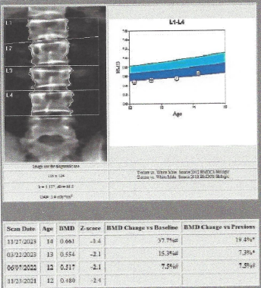
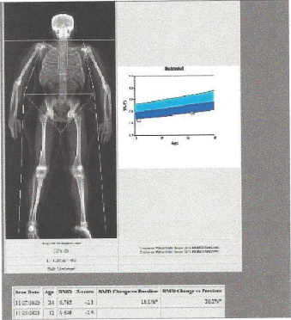
PURA Related Disorder and Low Bone Density with Bisphosphonate Use Joel Steelman MD, Ryan Lokkesmoe MD, Luke Hamilton MS
Background
PURA syndrome and 5q31.3 deletion syndrome, collectively known as PURA-related neurodevelopment disorders (PURA-NDD), are rare genetic conditions caused by a pathogenic change in one copy of the PURA gene or a deletion within the q31.3 region of chromosome 5 which includes the PURA gene,¹ leading to reduced activity of Pur-alpha protein. The condition is characterized by primarily by moderate-to-severe neurodevelopmental delay with additional common findings are summarized in table 1.
Figure 1: Bone Mineral Density Exams
Case Summary
A 12 year old male with a prior diagnosis of PURA-NDD was referred to the endocrine bone health clinic for investigation of a vertebral compression fracture. He had fallen backwards and landed on his buttocks with pain. L1 fracture diagnosed by MRI scan.
Pertinent medical history included developmental disability, dystonia, clumsiness, and mild scoliosis (6 degree lumbar scoliosis). He had experienced prior appendicular fractures with falls.
Physical findings on him included dysmorphic facies, height 95th percentile, obesity (BMI 117% of the 95th percentile), and Tanner stage 2 with 10 ml testicular volume. Laboratory work-up was pertinent for vitamin D deficiency - 22ng/mL (≥30ng/mL). Imaging studies are summarized in Fig 1. There was baseline low bone mass.
Given the mechanism of injury, it was decided to observe with supplementation of vitamin D. Bone density did improve with vitamin D supplementation (Fig 1). However, additional lumbar spine fractures were detected on scoliosis surveillance studies nine months after initial consultation. Treatment was escalated to IV zolendronate 0.05 mg/kg given every six months. He has received two infusions of zolendronate. He is without further fractures, and bone mineral density has shown improvement (Fig 1).
Discussion
Low bone mass has been reported in 10% of children with PURA-NDD.¹ To date, no direct impact of PURA on bone has been reported. PURA is associated in all reported cases with hypotonia. Low mass with associated fractures has been widely reported in low muscle tone conditions such as Duchenne Muscular Dystrophy (DMD) and Spinal Muscular Atrophy. These conditions have increased fracture risk, and bisphosphonates have been used to treat symptomatic low bone mass. It was decided based on these similar conditions and long-term experience with bisphosphonates in children to embark on a treatment trial.
In conclusion, IV zoledronate appears to be effective for the treatment of osteoporosis in this case of PURA-NDD. This is the first reported use of a bisphosphonate to treat PURA-NDD associated osteoporosis. Unanswered questions include if there is vertebral remodeling, does improved bone density translate to reduction in fractures, and what is the optimal duration of treatment and endpoints.
References
Reijnders MF, Leventer RJ, Lee BH, et al. PURA-Related Neurodevelopmental Disorders. 2017 Apr 27. In: Adam MP, Feldman J, Mirzaa GM, et al., editors. GeneReviews® [Internet]. Seattle (WA): University of Washington, Seattle; 1993-2023. Available from: https://www.ncbi.nlm.nih.gov/books/NBK426063/.
Next Reference
Symptom | Percent Reported
Hypotonia | 96%
Feeding Difficulties | 77%
Seizures | 54%
Vitamin D Deficiency | 42%
Low Bone Mass | 30%
Scoliosis | 26%
Table 1: Commonly Reported Symptoms in PURA-NDD^{Source?}

