Slide 1
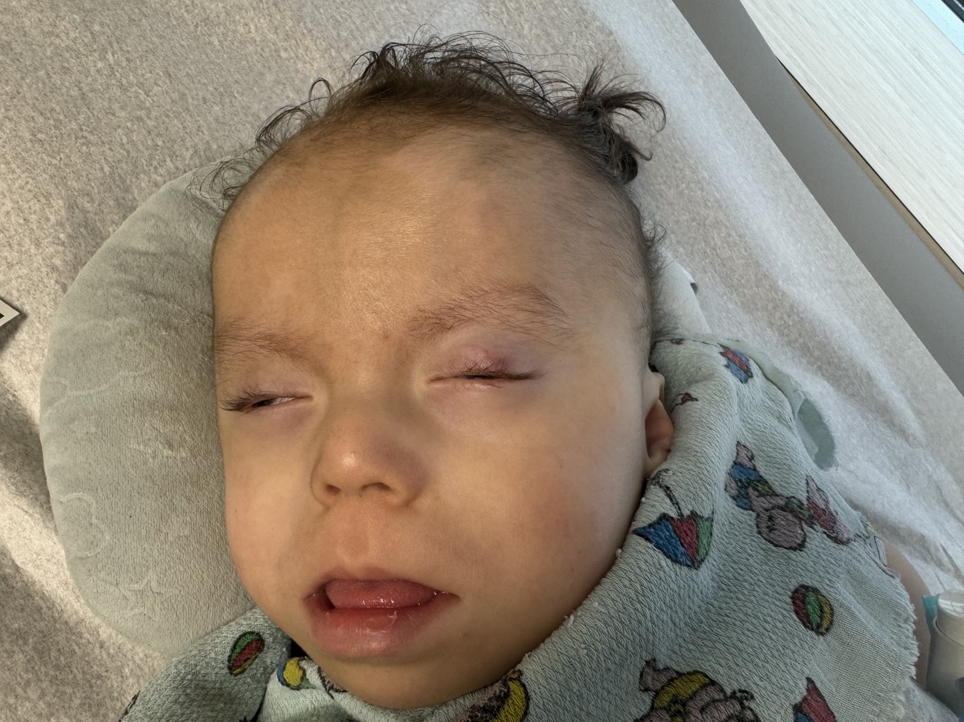
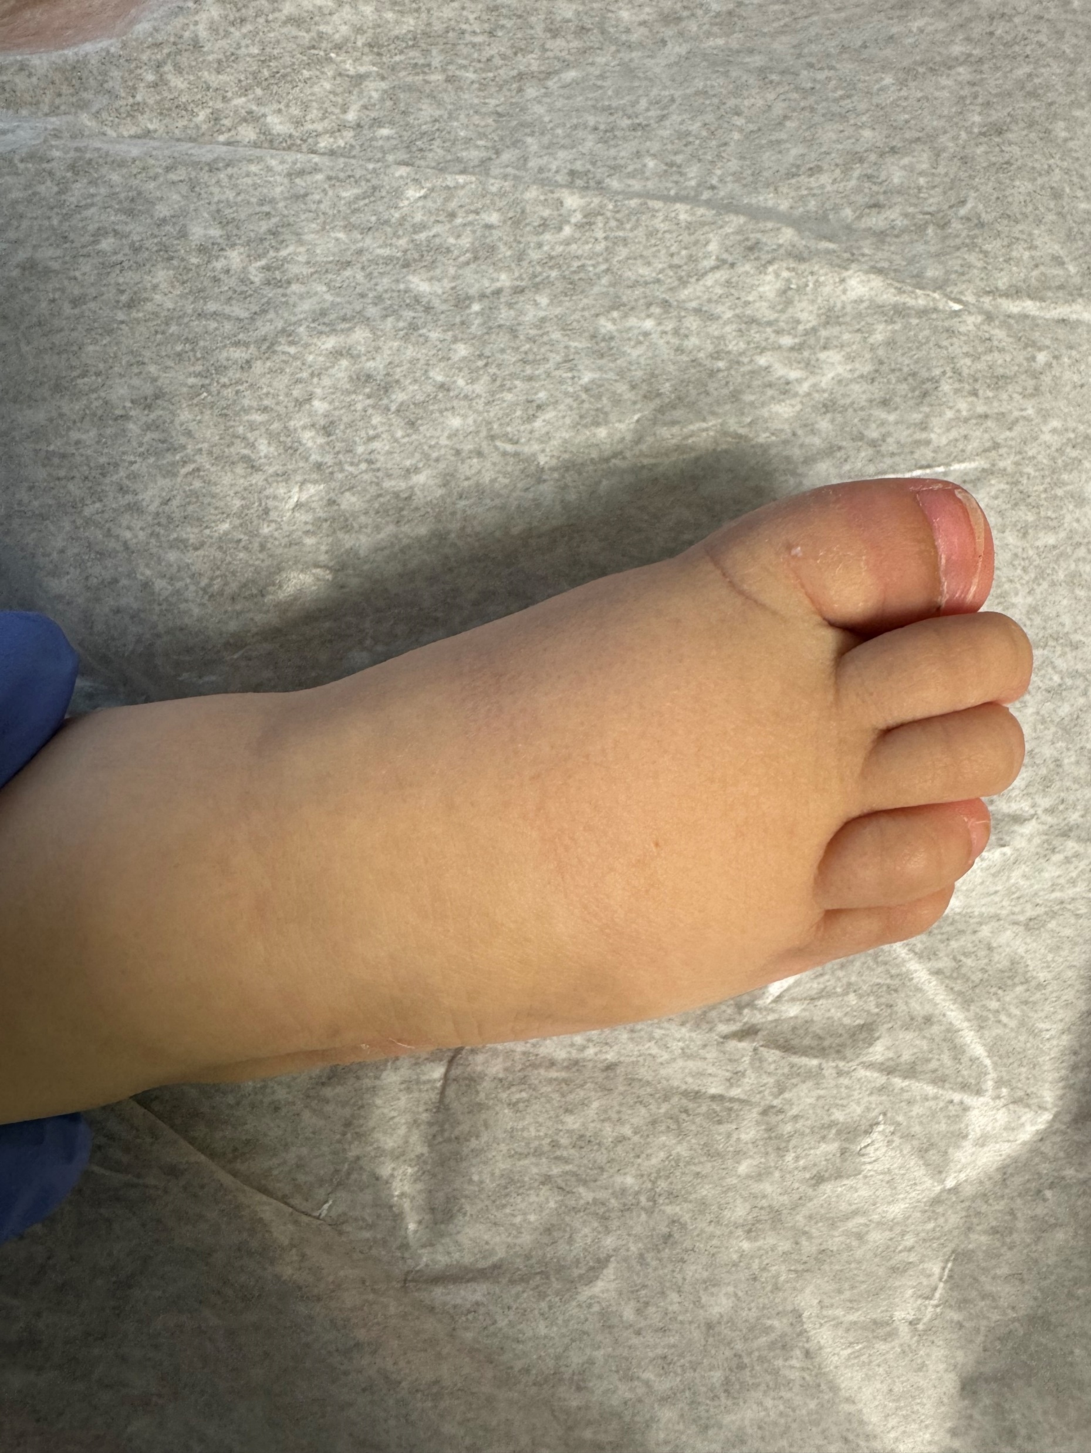
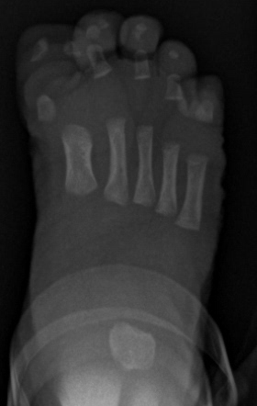
Pallister‐Killian Syndrome: Case Report Of Hypoparathyroidism
Maria C. Caldas – Vasquez, MD. Julie Eapen, MD
Department of Pediatrics
Introduction
Learning Objectives:
Describe clinical presentation of Pallister-Killian Syndrome (PKS)
Report a case of PKS with hypoparathyroidism
Pallister-Killian syndrome (PKS) is a sporadic genetic disorder caused by tissue-limited mosaicism of an extra isochromosome of 12p, also known as 12p tetraploid syndrome or 12p isobrachial chromatid syndrome (1). Was initially described by Pallister et al. in 1977 and again in 1981 by Killian and Teschler‐Nicola. It is estimated to affect 5.1 per 1,000,000 live births (2). This condition can be diagnosed prenatally by chorionic villus sampling, amniocentesis, or cordocentesis (3).
The clinical features are highly variable, involving a variety of phenotypes associated with multiple systems (2) Please see table 1.
Table 1
Clinical Manifestations of PKS (2)
There are no cases of PKS reported in the medical literature presenting with hypoparathyroidism.
Fig.1 Facial appearance of the patient. Alopecia/Sparse temporal hair, epicanthic folds and slightly low-set ears, prominent forehead, hypertelorism, up- slanting palpebral fissures, anteverted nostrils, long philtrum, everted lower lip, short neck
Table 2. Laboratory results at time of endocrinology evaluation and patient on treatment
Case Report
An 18-month-old male presented for endocrine evaluation for management of calcitriol.
Perinatal History
Pallister-Killian syndrome (PKS) was diagnosed via Chromosomal Microarray following amnioreduction and Non-invasive prenatal testing, done at 29 weeks after abnormal prenatal ultrasound reporting polyhydramnios and possible skeletal dysplasia. Maternal age 22 years-old with prenatal care started at 4 months, mother taking prenatal vitamins and iron. No exposure to chemicals, tobacco, alcohol, and illicit drugs. Pregnancy is complicated by polyhydramnios. Born at 34 weeks via c-section with the following birth measurements: Weight: 3.1kg (96th percentile), length: 44.6 cm (37th percentile), head circumference: 34 cm (95th percentile).
Postnatally patient was noted to be large for gestational age, with shortened long bones, variable tone, high frontal hairline, low set ears posteriorly rotated and overfolded, cleft palate, cryptorchidism bilaterally, contracture of 5th toe, hypoplastic nail on 5th toe, ASD and aortic dilation.
Family History
No other family members with birth defects, learning disabilities, early deaths, or recurrent miscarriages. Consanguinity was denied.
Clinical Course
The patient was in the neonatal intensive care unit for 1 month for respiratory support, failed PO feedings, and was discharged with gastrostomy with optimal weight gain. He had a multidisciplinary evaluation by genetics, pulmonary, surgery, and neurology. Discharged on 400 international units of vitamin D with no evidence of hypocalcemia during neonatal course. Newborn screening was normal.
During a hospital admission at 17-month-old for respiratory distress, the patient was placed on calcitriol 0.5 mcg per day, without evidence of hypocalcemia. After discharge, the pediatrician referred the patient to endocrine for management of calcitriol and further workup. Laboratories obtained showed a low PTH with normal calcium level (see Table 2). Repeated PTH levels revealed persistent low PTH. The child has been stable on calcitriol and vitamin D supplementation, with no evidence of renal calcifications in the kidney ultrasound. Optimal weight on gastrostomy feeds. No hypocalcemia was noted in follow-up laboratories or symptoms of hypocalcemia.
Table 2. Laboratory results at time of endocrinology evaluation and patient on treatment
Testing | Results | Normal Range
Corrected Calcium | 9.4 mg/dL | 8.5 - 10.6 mg/dL
Phosphorus | 5.9 mg/dL | 4.0 - 8.0 mg/dL
Magnesium | 2.4 mg/dL | 1.5-2.5 mg/dL
Vitamin D, 25-Hydroxy | 85 ng/dL | 30-100 ng/dl
PARATHYROID HORMONE, INTACT | 8 pg/mL | 14-66 pg/mL
Discussion
Pallister-Killian syndrome is a rare genetic condition that is associated with tetrasomy in chromosome 12 (1,2). Despite the presence of multisystem manifestations of this genetic condition, we report a case associated with hypoparathyroidism.
Early prenatal diagnosis helps families to cope with the pregnancy and the care of the infant after birth In the prenatal diagnosis of PKS, the use of SNP-array and FISH with conventional karyotype are key to seeking i(12p) and for precise diagnosis (4). Prenatal diagnosis was possible given the presence of polyhydramnios, which led to the diagnosis after amniocentesis/amnioreduction.
The mechanism of i(12p) formation is still not clear. Previous literature has illustrated that maternal meiotic II nondisjunction is a mechanism of tetrasomy 12 mosaicism, although there were several reports of paternal nondisjunction (5,6).
Conclusion
It is unknown if individuals with Pallister-Killian syndrome are at risk for hypoparathyroidism, further studies should be directed to determine the mechanism of hypoparathyroidism in PKS.
Timely diagnosis of PKS is crucial as it poses a substantial emotional and financial strain on families.
Pediatric endocrinologists will likely be consulted to assist with the cases of PKS and should be able to recognize its features to aid with the diagnosis and care of these patients.
Consent of Publication
The parents of the patient gave written informed consent allowing the publication and the images published.
Bibliography
Wu X, Xie X, Su L, Lin N, Liang B, Guo N, Chen Q, Xu L, Huang H. Prenatal diagnosis of Pallister-Killian syndrome and literature review. J Cell Mol Med. 2021 Sep;25(18):8929-8935. doi: 10.1111/jcmm.16853. Epub 2021 Aug 18. PMID: 34405543; PMCID: PMC8435413.
Stone L, Tripuraneni R, Bain M, Hernandez C. Pallister-Killian syndrome in a two-year-old boy. Clin Case Rep. 2017 Apr 8;5(6):774-777. doi: 10.1002/ccr3.892. PMID: 28588808; PMCID: PMC5457980.
Srinivasan A, Wright D. Pallister-Killian syndrome. Am J Case Rep. 2014 May 7;15:194-8. doi: 10.12659/AJCR.890614. PMID: 24826207; PMCID: PMC4018245.
Wang T, Ren C, Chen D, Lu J, Guo L, Zheng L, Liu Y, Chen H. Prenatal diagnosis of Pallister-Killian syndrome using cord blood samples. Mol Cytogenet. 2019 Aug 30;12:39. doi: 10.1186/s13039-019-0449-x. PMID: 31497069; PMCID: PMC6717365.
Shen JD, et al. Pallister-Killian syndrome: meiosis II non-disjunction may be the first step in the formation of isochromosome 12p. Chin Med J. 2010;123(23):3482–3485.
McLeod DR, Wesselman LR, Hoar DI. Pallister-Killian syndrome: additional manifestations of cleft palate and sacral appendage. J Med Genet. 1991 Aug;28(8):541-3. doi: 10.1136/jmg.28.8.541. PMID: 1920372; PMCID: PMC1016985
System | Clinical manifestations
Neurologic | Structural brain malformations (60–70%)
 | Epilepsy (53%) – myoclonic (56%), generalized convulsions (48%), clustered tonic spasms (30%)
Cardiac | Structural heart defects (40%)
 | Atrial & ventricular septal defects (15%)
 | Bicuspid aortic valve, aortic dilatation, patent ductus arteriosus, patent foramen ovale
Pulmonary | Diaphragmatic hernias with subsequent lung hypoplasia
Gastrointestinal (GI) | GI involvement (52%)
 | Intestinal malrotation (12%)
 | Congenital diaphragmatic hernia (11%)
 | Umbilical hernias
 | Displacement of anus
 | Feeding difficulty
 | Dysphagia
 | Gastroesophageal reflux disease
 | Constipation
Genitourinary | Cryptorchidism
 | Hypospadias
 | Small genitalia
 | Hydrocele
Musculoskeletal | Polydactyly
 | Joint contractures
 | Hip dislocations
 | Limb length discrepancies
Growth Pattern | Prenatal overgrowth – weight, length, and head circumference above 50th percentile
 | Postnatal growth deceleration
Audiologic | Hearing loss (77%) – typically bilateral, sensorineural (38%), conductive (29%), and mixed (33%)
Ophthalmologic | Ocular involvement (87%)
 | Visual impairment – strabismus, nystagmus, or myopia (75%)
 | Legally blind (19%)
Dermatologic | Hypo‐/hyperpigmentation (45%)
Fig.1 Facial appearance of the patient. Alopecia/Sparse temporal hair, epicanthic folds and slightly low-set ears, prominent forehead, hypertelorism, up- slanting palpebral fissures, anteverted nostrils, long philtrum, everted lower lip, short neck
Fig.2 Picture of the right foot (A), and radiograph of right foot (B) demonstrating short toes with a bifid right great toe distal phalanx (arrow)
A
B

