Slide 1
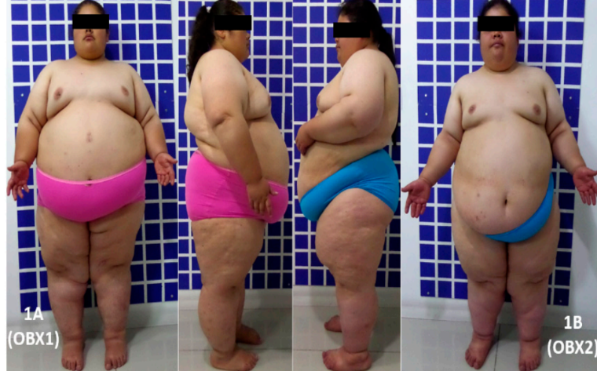
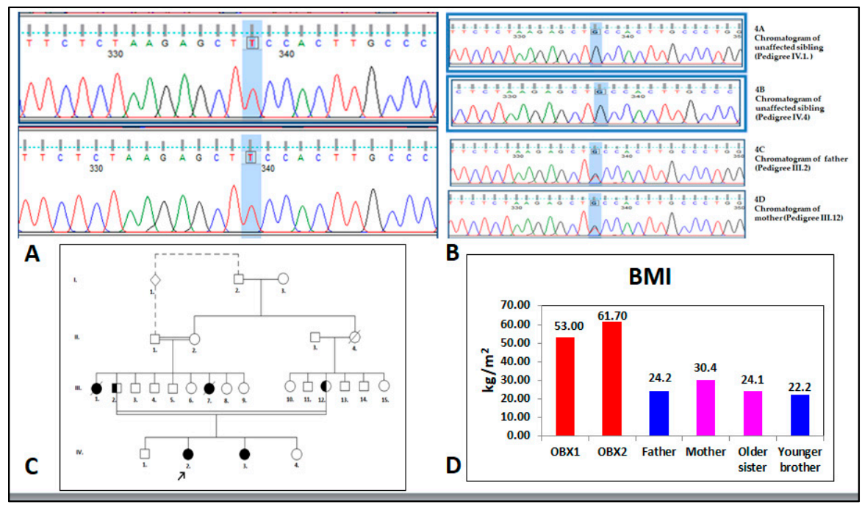
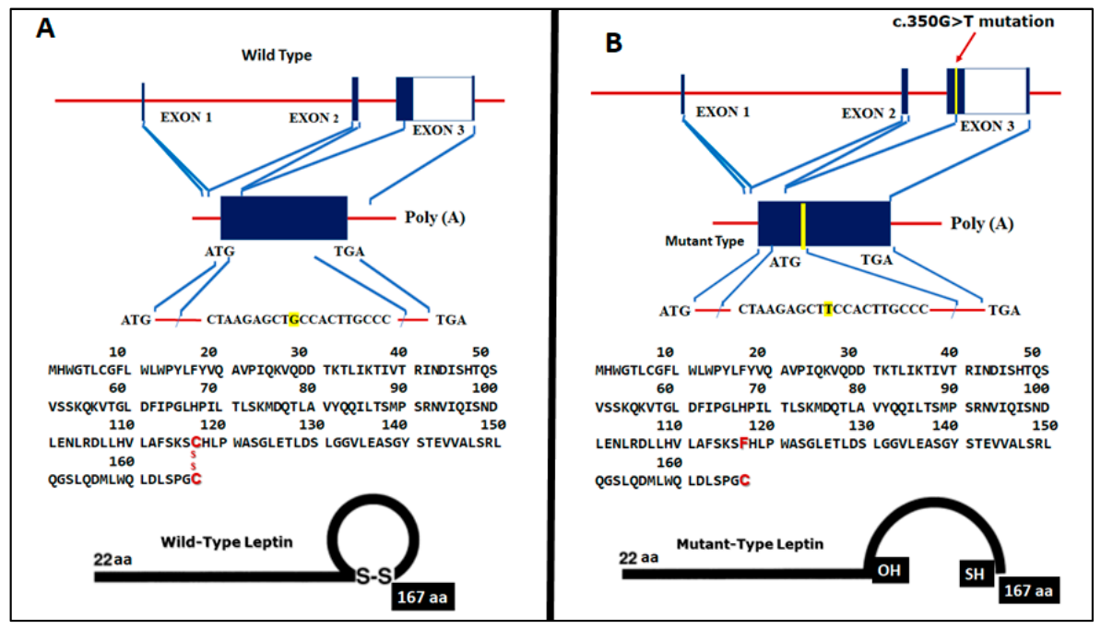
Congenital Leptin Deficiency and Leptin Gene Missense Mutation Found in Two Colombian Sisters with Severe Obesity
H. Yupanqui-Lozno 1 , R. Bastarrachea 2 , M. Yupanqui-Velazco 1 , M. Alvarez-Jaramillo 3 , E. Medina-Méndez 4 , A. Giraldo-Peña 5 , A. Arias-Serrano 5 , C. Torres-Forero, et al.
1 Dexa Diab IPS, Bogotá 110221, Colombia; h.yupanqui1@hotmail.com (H.Y.-L.); maria.yupanquiv@gmail.com (M.E.Y.-V.) 2 Texas Biomedical Research Institute, San Antonio, TX 78227, USA; raul@txbiomed.org (R.A.B.); ernito18@gmail.com (E.R.-A.); edna.navag@uanl.mx (E.J.N.-G.); jkent@txbiomed.org (J.W.K.J.); scole@txbiomed.org (S.A.C.) 3 Facultad de Medicina, Fundación Universitaria Juan N. Corpas, Bogotá 111161, Colombia; monica.alvarez@juanncorpas.edu.co 4 Genetica Molecular de Colombia, Bogotá 111221, Colombia; oseban87@gmail.com
No Conflicts of Interest to Report
Introduction
A relevant finding was the identification of a novel LEP gene variant (NM_002303.3), C.350G>T (p.C117F) that was present in the homozygous state in both sisters. This variant occurred within exon 3 in a functional part of the leptin protein, which has been highly conserved during evolution
The sister’s leptin levels were below the detection limit of the kit. (3.7–11.1 ng/mL)
Obesity is a pandemic worldwide and is closely associated with multiple metabolic disturbances. Obesity is a heritable disorder. Although most forms of obesity are influenced by both genetic and environmental factors, monogenic obesity is a very rare type of obesity, which is caused by a mutation in a single gene and is usually not significantly affected by the environmental factors, resulting in severe obesity in early childhood.
Several genes, such as pro-opiomelanocortin (POMC), leptin receptor (LEPR), leptin (LEP), proconvertase 1 prohormone convertase 1 (PCSK1), and melanocortin 4 receptor (MC4R), may have mutations that can lead to monogenic obesity, together accounting for 3–5% of non-syndromic cases.
In this article, we report a novel homozygous missense mutation [NM_002303.3], c.350G>T [p.C117F] in LEP associated with very low serum leptin concentrations, hyperphagia, and early-onset obesity in two severely obese sisters from Colombia born from consanguineous parents.
Discussion
Obesity can be a heritable disorder. However, only less than 5% of patients with extreme obesity are caused by single gene mutations. In highly consanguineous families, a striking amount of cases with extreme obesity due to monogenic mutations (up to 30%) can be identified.
The majority of mutations of LEP have been associated with high rates of consanguinity, as in the present case. The prevalence of consanguinity in Colombia is the third highest in South America after Brazil and Venezuela at 1.30%. Three regions in Colombia (Santander, Boyacá, and Antioquia) have high levels of inbreeding.
The clinical picture was quite similar in both sisters: severe obesity, primary amenorrhea, insulin resistance, hypertriglyceridemia, acantosis nigricans, and hyperphagia. Although a formal assessment of appetite was not conducted, we were able to document a history of marked hyperphagia.
Although of normal weight at birth, both sisters suffered from severe, intractable obesity from an early age. The sisters had no additional clinical features to suggest that they might have a pleiotropic genetic syndrome associated with obesity, such as Prader–Willi syndrome.
. We detected a novel mutation Leptin mRNA (NM_000230.2): c.350G>T (p.C117F) in the severe obese sisters, speculating that this homozygous mutation in their LEP gene to be causal to their monogenic obesity. This missense mutation occurred in nucleotide 350 in the gene’s encoding sequence, with guanine (G) being replaced by thymine (T), in turn causing a cysteine (Cys) replacement by phenylalanine (Phe) in amino acid 117, thereby affecting an amino acid residue that has been conferring stability to the tertiary structure of the protein (Figure 3A,B). The Cys in leptin at position 117 is responsible for the intramolecular disulfide bond. The formation of an intramolecular disulfide bridge is necessary for normal processing and secretion of leptin [52]. To our knowledge, this is the first time that a putatively causal LEP mutation has been reported in the continents of North and South America.
Case report
OBX2:
She was first seen in the practice setting at age 6. She is the third child of the nuclear family and younger sister of OBX1. She has consulted for early childhood-onset morbid obesity and primary amenorrhea; she had hypertriglyceridemia, insulin resistance, and acantosis nigricans. She was receiving 600 mg of gemfibrozil and 850 mg of metformin as daily treatment. She was born after a 38-week pregnancy involving non-hospital vaginal delivery; somatometry at birth was not obtained, although the mother stated that her weight and height at birth were normal and similar to that of her sister. Development and thriving was similar to her sister.
Conclusions
OBX1:
She was first seen in the practice setting at the age of 9yrs for early childhood-onset morbid obesity, primary amenorrhea, and acne on the chest. She was a second child, born after a 38-week uneventful pregnancy and delivery; normal weight and height at birth. There was no presence of failure to thrive during the first two years. Progressive weight gain was observed reaching a BMI of 40 kg/m2 at 14 years-old. Bariatric surgery (sleeve gastrectomy) was performed when she was 16 years-old, after she reached 120 kg weight and a BMI of 53 kg/m2 . Her weight decreased to 100 kg following surgery, but it progressively increased to 141 kg over the last 5 years in spite of a dietary approach including a low fat and low sugar diet, along with a 60-min walk daily.
Her parents are first cousins, and her maternal and paternal grandmothers are sisters. Her father weighs 70 kg, his height is 170 cm (BMI = 24.2 kg/m2 ), and he is 52 years old. Her mother weighs 72 kg, her height is 154 cm (BMI = 30.4 kg/m2 ), and she is 48 years old. Her older sister weighs 68 kg, her height is 168 cm (BMI = 24.1 kg/m2 ), and she is 27 years old. Her younger brother weighs 50 kg, his height is 150 cm (BMI = 22.2 kg/m2 ), and he is 17 years old. A paternal aunt who died aged 29 years old suffered from extreme obesity, primary amenorrhea, diabetes mellitus, and leukemia; another paternal aunt developed rapid-onset obesity and died at one year of age, having been born with a healthy appearance.
Physical examination: Age 24 yrs, BP 109/72 mm Hg, HR 69 bpm, weight was 143.9 kg, height was 149.7 cm, waist circumference was 152 cm, and BMI was 64.2 kg/m2. She had severe obesity, normocephaly (without cognitive or motor deficit), average intelligence, left eye moderate strabismus, mild hirsutism (Ferriman and Gallwey score 11), hair in the maxillary region, mild acantosis nigricans, abundant panniculus adiposus, Tanner stage breast development V, female genitals with Tanner stage V pubic hair, abundant lower limb telangiectasia, pain on mobilizing the left knee, small hands and feet, clinodactyly, and nail hypoplasia (Figure 1 A).
Biochemistry panel: was 19.9 pg/mL for estradiol (12.5–166 pg/mL reference value (RV), 6.58 mUI/mL for FSH (5.8–21 mUI/mL RV), 2.71 mUI/mL for LH (1.1–11.6 mUI/mL RV), 4.89 mUI/mL for prolactin (1.39–24.2 mUI/mL RV), 0.84 mUI/mL for TSH (0.4–4 mUI/mL RV), and a nuclear magnetic resonance of the hypophysis was reported normal. Her last report in fasting cardiovascular risk and metabolic clinical chemistry was glucose 77 mg/dL, insulin 19.9 µIU/mL, HDL cholesterol 43 mg/dL, triglycerides 327 mg/dL, and HbA1c 6.6%.
We report here findings from two Colombian sisters with congenital leptin deficiency and early-onset severe obesity born from parents with known consanguinity. The molecular diagnosis of this rare genetic disorder is important due to the possibility of treatment with recombinant leptin
Physical examination: Age 22yrs, BP was 106/70 mm Hg, HR was 93 bpm, weight was 133.45 kg, height was 147.1 cm, waist circumference was 144 cm, and BMI was 61.7 kg/m2 .
She had severe obesity, a normal neurological exam, average intelligence, a severe left eye strabismus, mild hirsutism (Ferriman and Gallwey score 11), acantosis nigricans on the neck, mild acne on the chest, abundant abdominal and body panniculus adiposus, Tanner breast development stage V, normal external female genitals, Tanner stage V , and telangiectasias in both lower limbs, clinodactily, nail hypoplasia, and bilateral fifth toe hypoplasia.
Clinical biochemistry panel: 19.2 pg/mL for estradiol (12.5–166 pg/mL RV), 4.17 mUI/mL for FSH (5.8–21 mUI/mL RV), 2.93 mUI/mL for LH (1.1–11.6 mUI/mL RV), 5.37 mUI/mL for prolactin (1.39–24.2 mUI/mL RV), 2.26 mUI/mL for TSH (0.4–4 mUI/mL RV) and a nuclear magnetic resonance of the sella turcica was reported normal. Her last report in fasting cardiovascular risk and metabolic clinical chemistry was glucose 89 mg/dL, insulin 6.0 µIU/mL, HDL Cholesterol 51 mg/dL, triglycerides 203 mg/dL, and HbA1c 5.4%.
Bibliography
Knight, J.A. Diseases and disorders associated with excess body weight. Ann. Clin. Lab. Sci. 2011, 41, 107–121. 2. Styne, D.M.; Arslanian, S.A.; Connor, E.L.; Farooqi, I.S.; Murad, M.H.; Silverstein, J.H.; Yanovski, J.A. Pediatric Obesity-Assessment, Treatment, and Prevention: An Endocrine Society Clinical Practice Guideline. J. Clin. Endocrinol. Metab. 2017, 102, 709–757. [CrossRef] [PubMed] 3. Butte, N.F.; Comuzzie, A.G.; Cole, S.A.; Mehta, N.R.; Cai, G.; Tejero, M.; Bastarrachea, R.; Smith, E.O. Quantitative genetic analysis of the metabolic syndrome in Hispanic children. Pediatr. Res. 2005, 58, 1243–1248. [CrossRef]
2. Styne, D.M.; Arslanian, S.A.; Connor, E.L.; Farooqi, I.S.; Murad, M.H.; Silverstein, J.H.; Yanovski, J.A. Pediatric Obesity-Assessment, Treatment, and Prevention: An Endocrine Society Clinical Practice Guideline. J. Clin. Endocrinol. Metab. 2017, 102, 709–757. [CrossRef] [PubMed]
3. Butte, N.F.; Comuzzie, A.G.; Cole, S.A.; Mehta, N.R.; Cai, G.; Tejero, M.; Bastarrachea, R.; Smith, E.O. Quantitative genetic analysis of the metabolic syndrome in Hispanic children. Pediatr. Res. 2005, 58, 1243–1248. [CrossRef]
4. O’Rahilly, S.; Farooqi, I.S. Human obesity as a heritable disorder of the central control of energy balance. Int. J. Obes. (2005) 2008, 32 (Suppl. 7), S55–S61. [CrossRef] [PubMed]
Results
Sequencing of the genes LEP, LEPR, PPARG, MC4R, PCSK1, and POMC revealed the presence of three polymorphisms in LEP not associated with the patients’ clinical picture: c.198G>C (14% allele frequency), c.668A>G (41%), and c.3057G>A (46%), (all missense); such variants were considered normal polymorphisms due to their high frequency in the population. Furthermore, two missense variations were considered neutral for the PCSK1 gene (NM_00439.4) located in c.2069G>C (25% allele frequency) and c.661A>G (1.7%) (data not shown).
Notes:
Canva: redimension y diseño : 105x90

