Slide 1
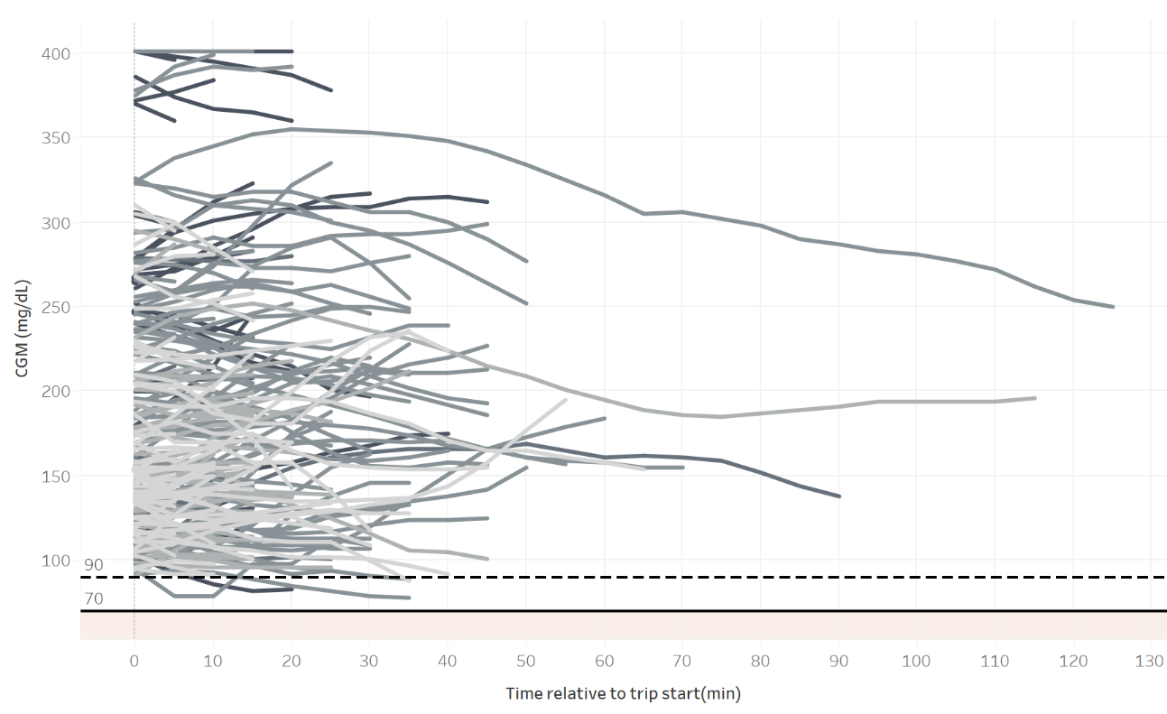
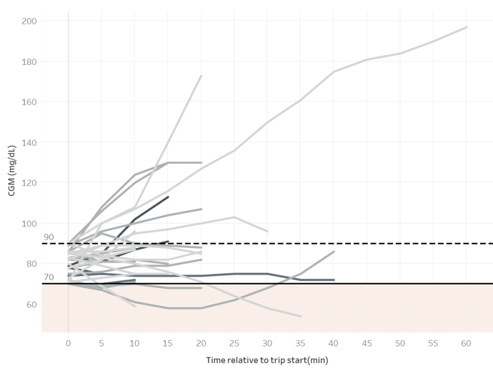
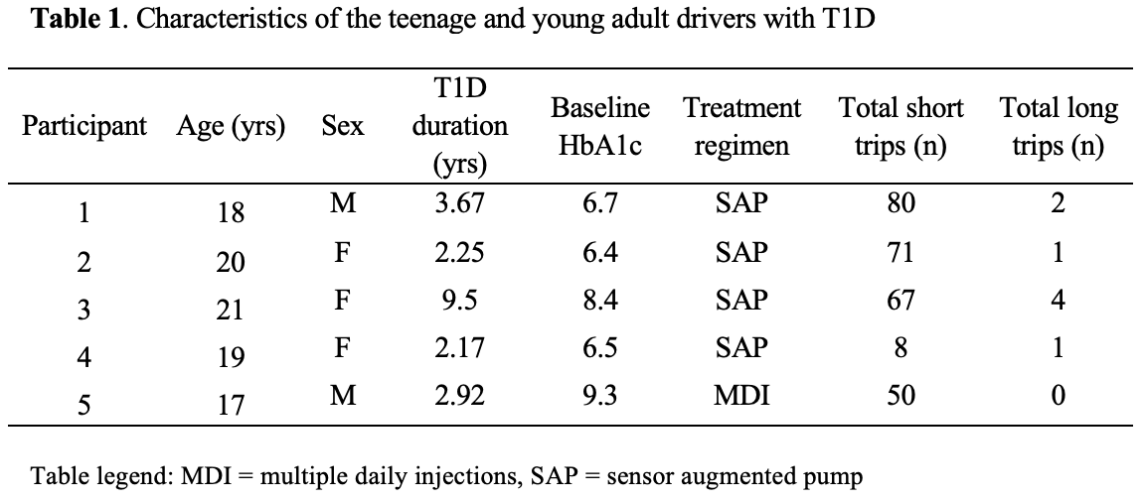
Driving in Teens and Young Adults with Type 1 Diabetes: Real-World Evidence for Minimizing Hypoglycemia Risk
Our real-world data shed light on hypoglycemia risk in young drivers with T1D, providing evidence in support of current the ADA guideline for glucose >90 mg/dL before driving
¹M.L. Ferm, MD, ²K. Pamidimukkala, MS, ²M. Erraguntla, PhD, ³S. Menon, MD, ¹C. Villegas, MS, ¹S. McKay, MD, and ¹D.J. DeSalvo, MD
¹Department of Pediatrics, Baylor College of Medicine, USA, ferm@bcm.edu
²Department of Industrial and Systems Engineering, Texas A&M University, USA
³Department of Pediatrics, West Virginia University/Charleston Area Medical Center, USA
Figure 1. Plots of CGM values during drives. A. Trips with initial glucose >90 mg/dL. B. Trips with initial glucose of 70-90 mg/dL
A.
B.
Background
American Diabetes Association (ADA) guidelines on driving with diabetes suggest¹:
Checking blood glucose before driving & at regular intervals during drives >1 hour
Consuming a snack before driving if starting blood glucose is 70 – 90 mg/dL
Never driving with a low blood glucose
Few studies have examined glycemic data while driving and there are no published data on teens or young adults
Methods
We collected CGM data from 5 drivers with T1D (median age 19, range 17-21 years) over a 1-month period
Trips were categorized as short (<60 minutes) or long (≥60 minutes)
Hypoglycemia was defined as <70 mg/dL for at least four consecutive CGM readings.
Trips <10 minutes were excluded
Results
284 eligible trips were recorded
For short trips, no hypoglycemia occurred with starting glucose >90 mg/dL (n=227)
15% (n=5/32) of short trips with starting glucose 70 – 90 mg/dL included hypoglycemia
6% (n = 17/276) of short trips started with glucose <70 mg/dL
8 long trips were recorded, all with starting >90 mg/dL and none included hypoglycemia
No vehicular accidents were reported during the study period
Discussion/Conclusions
ADA recommends a starting glucose >90 mg/dL before driving¹ and our data support this recommendation as no hypoglycemia was noted on trips meeting this guideline
In a real-world setting, almost 8% (n = 22/284) of trips included periods of hypoglycemia, which is worrisome given the effects of neuroglycopenia on driving ability
Larger studies would be helpful in identifying and improving road safety concerns in young drivers with T1D
1. American Diabetes Association, Diabetes Care, 37:S97-103, 2014
Disclosure Statement: This work was supported by FDA grant P50FD006428. DJD served as an independent consultant for Dexcom and Insulet and his institution has received research supported from Insulet separate from this work.

