Slide 1
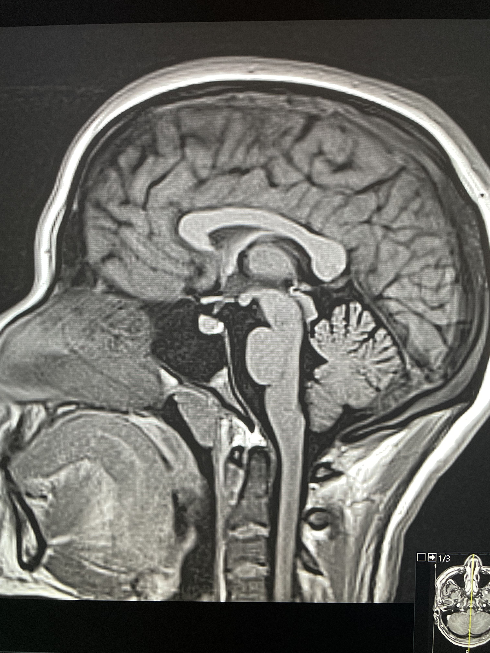
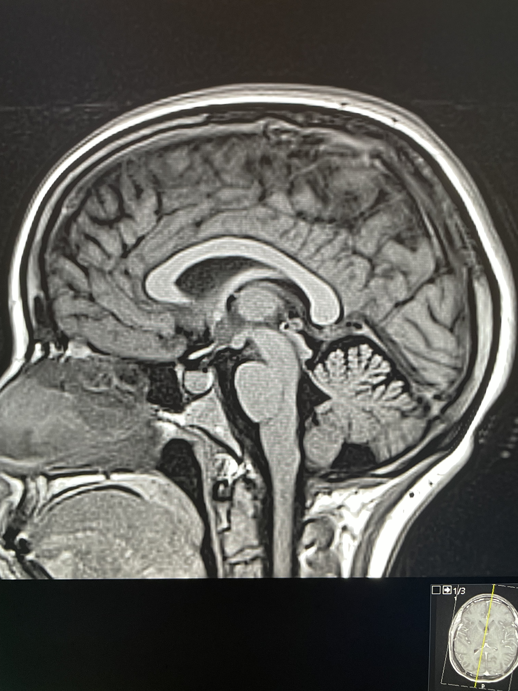
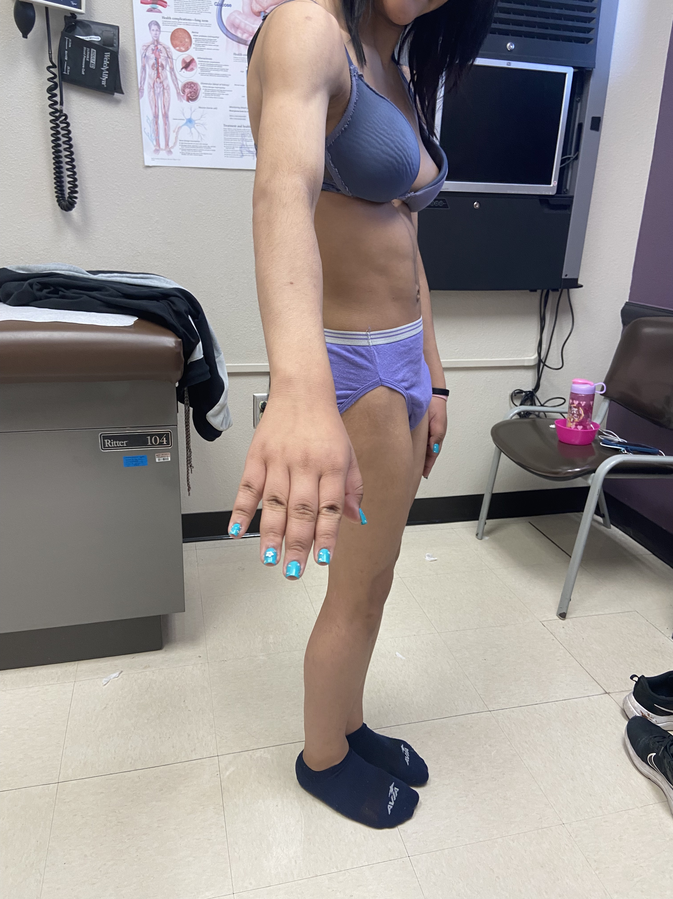
Congenital Generalized Lipodystrophy - An Undiagnosed Case in an Underserved Border Community
¹D. Evans, MS, ²A. Gutierrez, MD, ²S. Echetebu, MD, ²M. Zerah, MD
¹ Paul L Foster School of Medicine, Texas Tech, El Paso, TX, ²Department of Pediatrics, Texas Tech University Health Sciences Center El Paso, TX
INTRODUCTION
Table 1: Patient Laboratory Values
DISCUSSION
Introduction
Congenital Generalized Lipoatrophy (CGL) is a rare and life -threatening condition estimated to occur in 1 to 10 M individuals (1). It is characterized by a near total fat atrophy and progressive development of metabolic complications causing damage to internal organs. Affected individuals present with muscular pseudo-hypertrophy, acromegaloid features, severe hypertriglyceridemia, and hyperinsulinemia, leading to diabetes mellitus, possibly pancreatitis and liver disease. The median life expectancy is estimated to be 51.7 years (2).
Here we present a 16-year-old Hispanic female whose diagnosis was delayed until she was seen in our pediatric endocrine clinic. We present this case to raise awareness of this rare and severe disease.
 | December 22 | July 23 | September 23 | January 24
A1c (<5.7%) | 8.5% | 6.3% | 5.8% | 7.1%
Glucose (70-100 mg/dL) | 140 | 95 | 102 | 146
AST (12-32 U/L) | 36 |  | 16
ALT (5-32 U/L) | 51 |  | 20
Tryglycerides (35-150 mg/dL) | 1112 | 392 |  | 289
Leptin (06.-4.29ng/ml) |  |  |  | 1.7
HDL (40-59 mg/dL) | 32 | 30 |  | 33
LDL (50-100 mg/dL) |  | 21 |  | 64
TSH (0.55-5.31 mU/L) | 3.69
FSH (0.64-10.98 mIU/mL) |  | 7.87 | 6.1
LH (0.97-14.7 mIU/mL) |  | 1.73 | 1.7
Congenital Generalized Lipodystrophy (CGL) poses a diagnostic challenge due to its rarity and limited awareness among Primary Care Practitioners. Early recognition is vital, particularly when patients present with characteristic features such as abnormal fat distribution, acromegaloid appearance, or muscular body habitus, which may manifest at birth or shortly after. The development of insulin-resistant diabetes, hypertriglyceridemia, and other complications underscores the importance of prompt diagnosis and intervention.
In cases like the one discussed, where access to care and awareness of the condition are lacking, diagnosis may be delayed, leading to further complications. Despite attempts to initiate treatment with long-acting insulin or metreleptin, challenges such as patient reluctance and psychiatric comorbidities, like depression and suicidal ideation, may hinder optimal management.
Differentiating between BSCL1 and BSCL2 is vital, as they present with distinct genetic mutations and associated clinical features. While BSCL1 is more common and linked to AGPAT2 gene mutations, BSCL2 may involve mental retardation and cardiomyopathy in addition to lower leptin levels (3). Currently pending genetic evaluation at this time for this patient.
Ultimately, raising awareness among healthcare providers and addressing barriers to care are essential for improving outcomes in patients with CGL.
OGTT – Fasting 95 2 2 Hour GTT (mg/dL) | 1 Hour242 MG/DL (0’) 95 | 2 Hour229 MG/DL (60’) 242 | 3 Hour149 MG/DL (120’) 229
6/2023
First Endo Clinic Visit
Blood Data Collection
7/2023
CDE and Nutrition, Low-Fat, Low-Carb
Metformin 1000 mg
Atorvastatin 20 mg
9/2023
Stop Statin
Start Gemfibrozil 600 mg
2/2024
Attempt to start long–acting Insulin
11/2023
Outpatient Psych Admit, Depression and SI
Start Trileptal
CASE PRESENTATION
Timeline 1: Significant Management Points
Three years ago this patient moved from Juarez Mexico, to El Paso Texas. She had intermittent care until being evaluated in December 2021 by her PCP. She was then referred to Pediatric Endocrinology due to an elevated hemoglobin A1c (HgbA1c), hypertriglyceridemia, elevated liver enzymes. There were no complications during her birth, but the mother noted that the patient did not share any physical resemblance with her siblings. There was also no pertinent past medical history during childhood. Physical exam findings included large pointy chin, severe acanthosis nigricans on the neck and axillae. She had mild hirsutism, large hands and feet with prominent fatty deposits, defined musculature of her abdomen, extremities, and prominent phelbomegaly. Breast development was Tanner Stage IV and genitalia Tanner Stage V, no clitoromegaly, and oligomenorrhea.
The patient's metabolic abnormalities, including diabetes, hypertriglyceridemia, and elevated liver enzymes, showed rapid improvement with a low-carbohydrate, low-fat diet, and later with the addition of Metformin and Atorvastatin. Liver enzymes normalized, and ultrasound ruled out fatty liver disease. Additionally, signs of Polycystic Ovarian Syndrome (PCOS) were present, with elevated A1c, triglycerides, and free testosterone levels. Due to contraindications, oral contraceptives were not suitable for regulating the menstrual cycle in this patient.
2
3
4
CONCLUSION
Congenital Generalized Lipoatrophy is a rare and serious condition that can cause life threatening organ damage, namely to the liver and pancreas. It requires lifelong treatment and surveillance. As the disease progresses, the treatment increases in complexity. At such at late stage in the disease process this patient is at risk for uncontrolled hyperlipidemia and liver disease, necessitating the use of insulin or metreleptin therapy. This case is to increase awareness in underserved populations with limited access to care.
5
BIBLIOGRAPHY
Figure 4
Case Report Patient
Figure 5
Normal 17-year-old patient
1.Garg, A. N Engl J Med 2004;350:1220-34
2.Akinci, B. et al., J Clin Endocrinol Metab 88:5433-5437,2003
3. Agarwal, A. et al., J Clin Endocrinol Metab 88(10), 4840–4847
Figure 4 shows a midline sagittal T1 image of the patient’s brain, demonstrating diffusely diminished bone marrow signal in the Calvarium and Diploic Spaces. Compared to Figure 5, which is a patient of the same age, 17 years old, with normal marrow signal.
Figure 1
Figure 2
Figure 3

