Slide 1
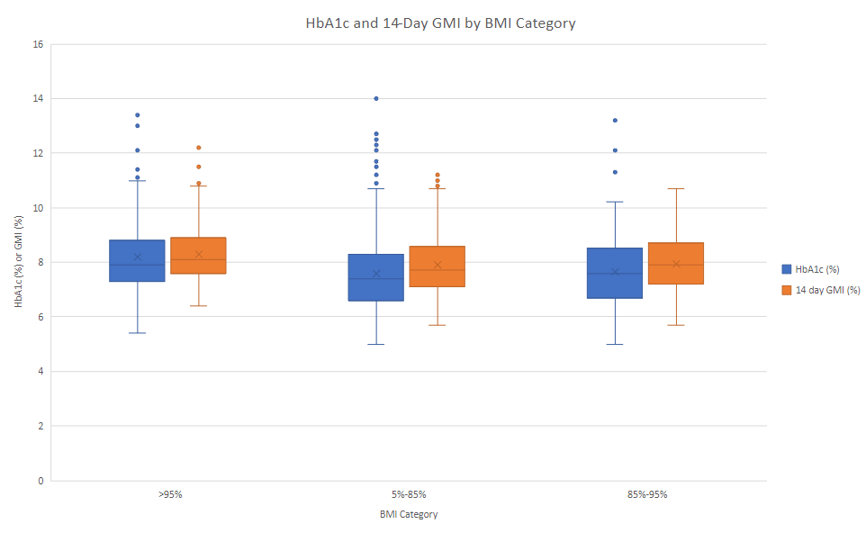
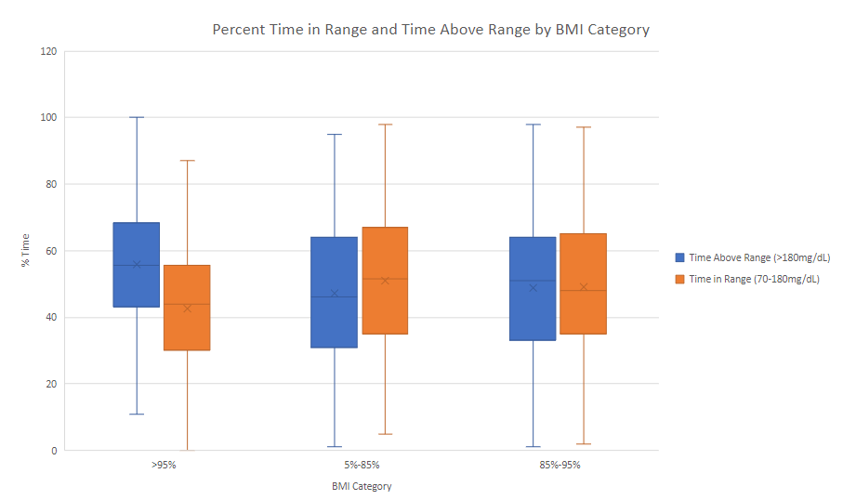
Across BMI categories, HbA1c and CGM metrics behaved similarly. Individuals in the obese category had significantly higher HbA1c, GMI, Time Above Range, and lower Time In Range when compared to both the normal and overweight groups.
Comparison of Hemoglobin A1c and CGM Metrics Across BMI Categories in a Diverse Pediatric Population
Non-Cognitive Predictors of Student Success: A Predictive Validity Comparison Between Domestic and International Students
There was no significant difference among the three BMI groups in age, prevalence of sex or treatment modality. Prevalence of private insurance (p<0.001) and distribution of race/ethnicity (p<0.001) were significantly different among BMI categories. Median T1D duration was also significantly different between the normal and overweight group (p=0.049).
There was no difference in median HbA1c, 14-day GMI, 14-day TIR, 14-day TAR, or 14-day TBR between the normal BMI and overweight BMI groups. Patients in the obese category had significantly higher HbA1c (p<0.001 vs both normal and overweight), 14-day GMI (p<0.001 vs normal, p=0.009 vs overweight), 14-day TAR (p<0.001 vs normal, p=0.007 vs overweight), and significantly lower 14-day TIR (p<0.001 vs normal, p=0.013 vs overweight) when compared in pairwise analyses with both the normal and overweight BMI categories. Youth with BMI in the obese category also had significantly lower TBR when compared to normal BMI youth (p=0.022).
CONCLUSION
Measures of glycemic control from CGM, as well as HbA1c, behave similarly across BMI categories.
Obesity was associated with suboptimal glycemic control
REFERENCES
Bergenstal RM, Beck RW, Close KL, et al. Glucose Management Indicator (GMI): A New Term for Estimating A1C From Continuous Glucose Monitoring. Diabetes Care. 2018;41(11):2275-2280.
Riddlesworth TD, Beck RW, Gal RL, et al. Optimal Sampling Duration for Continuous Glucose Monitoring to Determine Long-Term Glycemic Control. Diabetes Technol Ther. 2018;20(4):314- 316.
BACKGROUND:
Hemoglobin A1c (HbA1c) is the gold standard for long-term glycemic control, based on prospective studies such as the Diabetes Control and Complications Trial.
With the advent of continuous glucose monitor (CGM) technology, metrics derived directly from large numbers of sensor glucose (SG) values, such as the glucose management indicator (GMI), an estimae of HbA1c based on average SG, have become commonplace in clinical practice.
Studies have also linked the various CGM metrics (GMI, and percent time in different ranges of SG) to risks of long-term micro- and macrovascular complications, but discrepancies between sensor metrics and HbA1c are known to exist, especially between GMI and HbA1c.
This analysis compared HbA1c and CGM-derived glycemic control metrics across BMI categories in a large, diverse pediatric population, to determine if overweight or obesity are associated with discrepancies in markers of glycemic control.
METHODS
Inclusion: Youth with type 1 diabetes (T1D) using Dexcom G6 CGM and seen in-person at the Texas Children’s Hospital Diabetes Center from 1/1/22 to 11/30/22, with at least 70% wear time of CGM.
Clinical and demographic data collected14 and 90 day CGM metrics, HbA1c, duration of diabetes, BMI %ile, self-reported race/ethnicity (Non-Hispanic White (NHW), Hispanic (H), and Non-Hispanic Black (NHB)), age, sex, and insurance status.
The difference in 14 vs. 90-day GMI (∆GMI) was calculated as |GMI₁₄ –GMI₉₀|. A difference of ≥0.5% was considered clinically significant.
Continuous variables compared using Student’s T-test and categorical variables with Chi-squared test, or non-parametric equivalents as applicable
RESULTS
955 youth met eligibility criteria.
53.9% female, mean age of 11.62 years (SD 3.80), 67.5% privately insured, with 60.3% NHW, 13% NHB, and 26.8% Hispanic.
Mean HbA1c was 7.7% (SD 1.39), mean 14-day GMI of 7.98% (SD 1.05), and mean disease duration of 4.42 years (SD 3.40). Intensive insulin therapy with multiple daily injections (MDI) was used by 31.6% of youth, non-automated pumps were used by 40.4% of youth, and automated insulin delivery systems were used by 28% of youth.
AUTHORS
Alejandro F. Siller, MD, MSCI
James Sickler, MS-4
Carolina Villegas, MS, CCRP
Maria J. Redondo, MD, PhD
Daniel J. DeSalvo, MD
Notes:
Notes:
In Powerpoint, click View > Guides
Keep text within gutter guides.
Author list: Don’t split names onto two lines (e.g., “Jimmy [break] Smith”). If that happens, use a new line, unless you need the space. Bold the first names of anybody who’s presenting in person.
Intro/methods/result: Do not drop below font size 28, but if you have extra space, jack up the font size until the space is full.
Do not use color in the sidebars except in graphs/figures. It’ll pull attention from the center and slow interpretation for passersby.

